Slide 1


Tp2 : Face detection
Réalisée par :
Yasmine BEN SAAD
Chahnez KRAIEM

Slide 2

01
Feature engineering
03
Evaluating the Best Face Detector
02
Binary Classification using Scikit-Learn
04
Finding Faces in a New Image
Plan
05
Model Deployment with Python and Streamlit

Slide 3
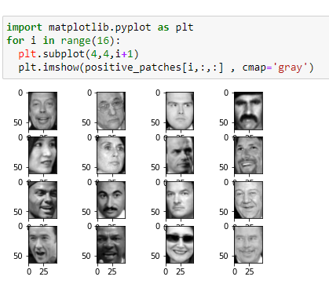
Feature engineering
Display the positive patches (people faces)

Slide 4

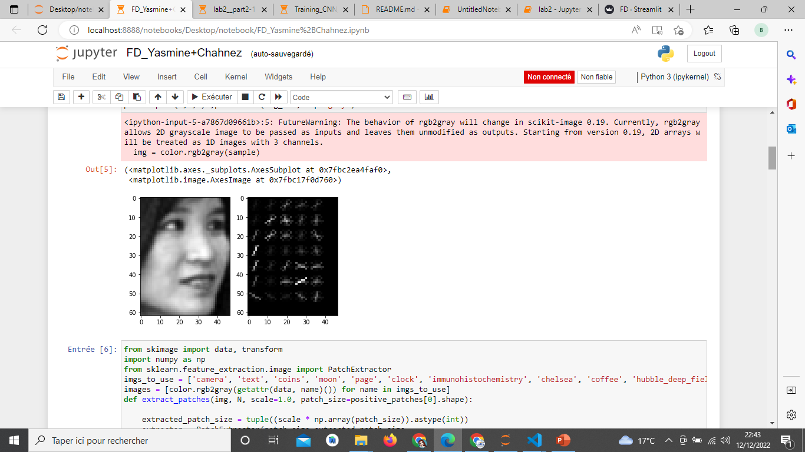
Feature engineering
The oriented gradients of HOG using the Scikit-Image’s HOG extractor
Notes:
extracting Histogram of Oriented Gradients (HOG) features using the Scikit-Image library.
The Histogram of Oriented Gradient (HOG) feature descriptor is popular for object detection ,
Algorithm overview
Compute a Histogram of Oriented Gradients (HOG) by
(optional) global image normalisation
computing the gradient image in x and y
computing gradient histograms
normalising across blocks
flattening into a feature vector

Slide 5
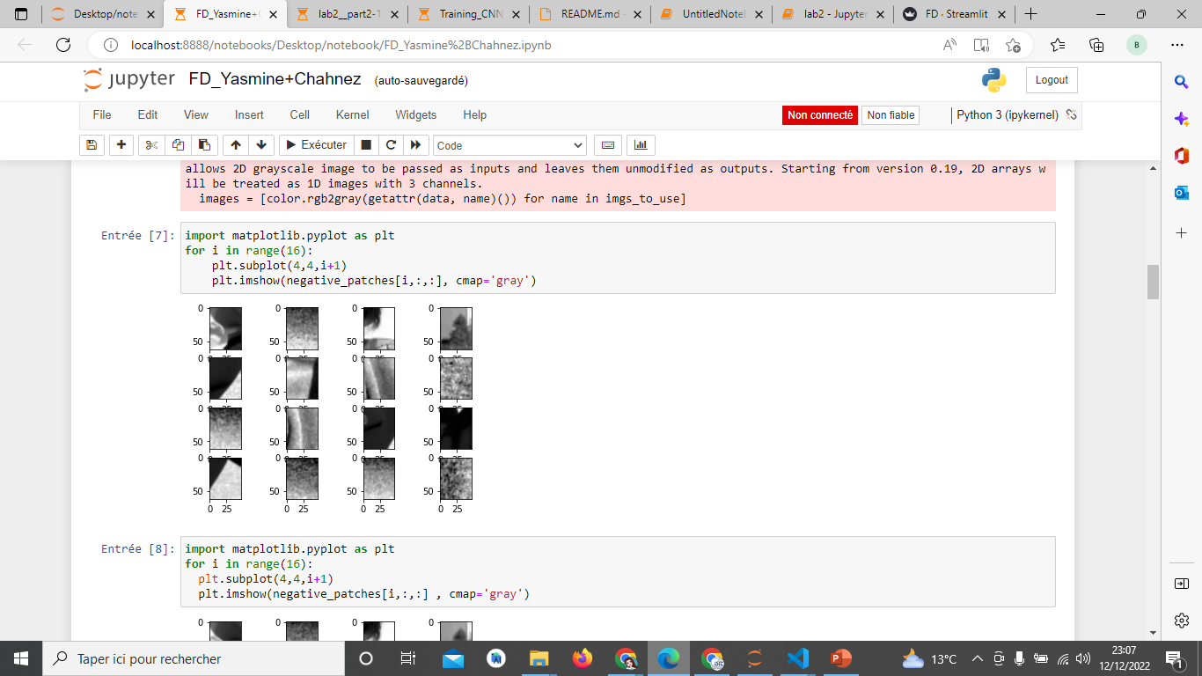
Feature engineering
Extraction of the negative patches

Slide 6
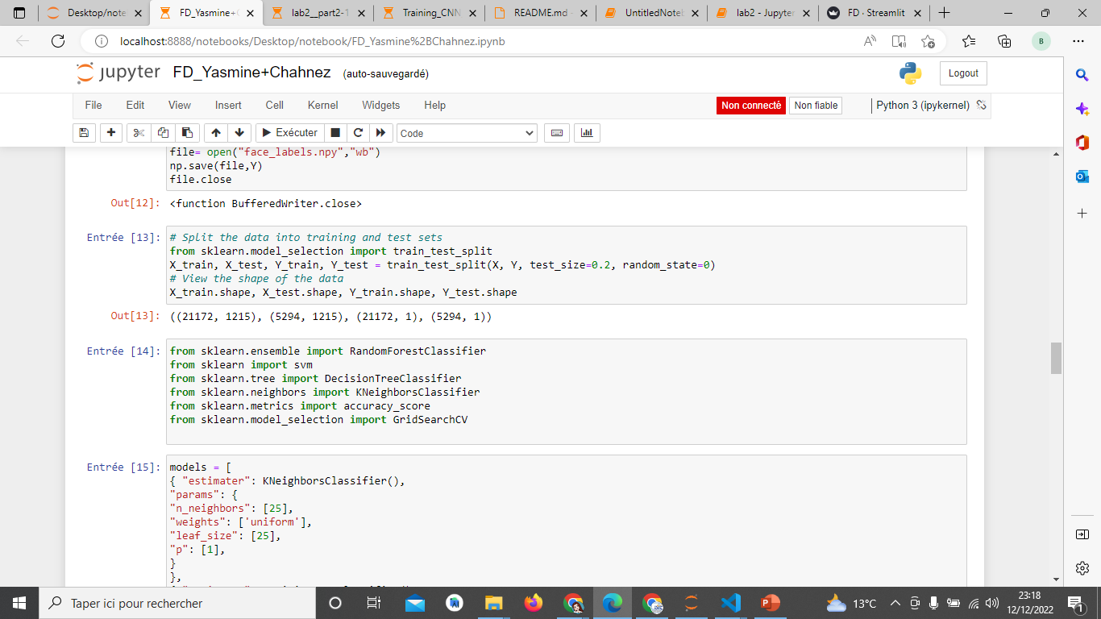
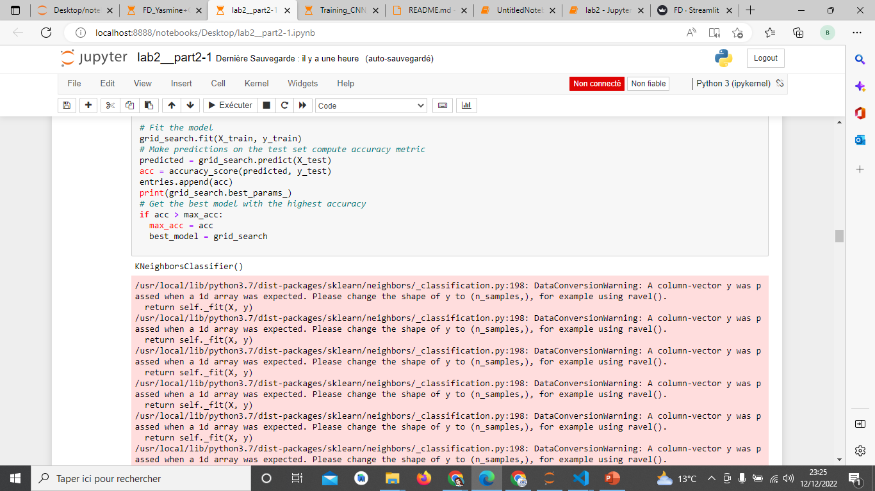
Binary Classification using Scikit-Learn
Split the data: training data and testing data
we build different binary classifiers with the best estimator : RandomForestClassifier | DecisionTreeClassifier | KNeighborsClassifier | svm

Slide 7
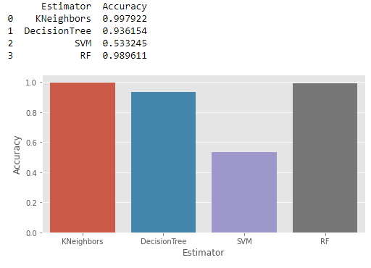
Feature engineering
Kneighbors has the highest accuracy
=> best model

Slide 8
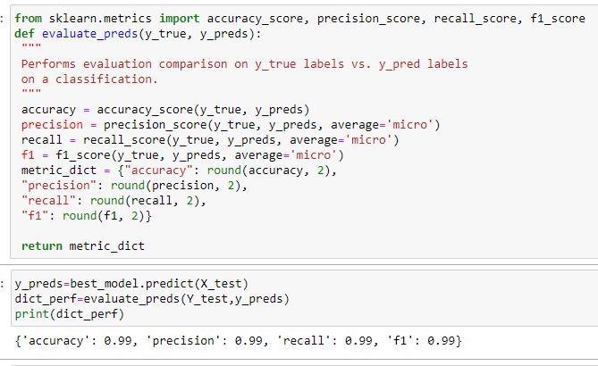
Evaluating the Best Face Detector
The performance of our best model

Slide 9
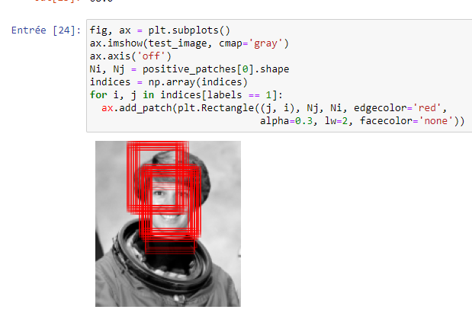
Finding Faces in a New Image
A red face detected patch

Slide 10
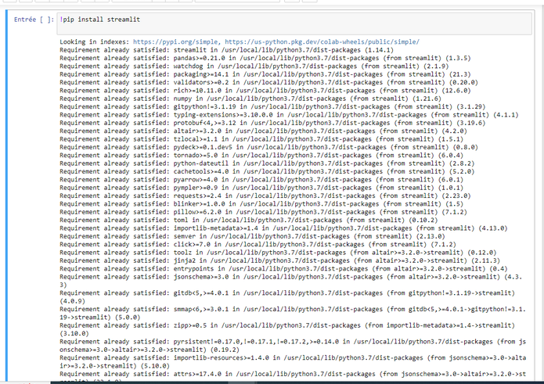
Model Deployment with Python and Streamlit

Slide 11
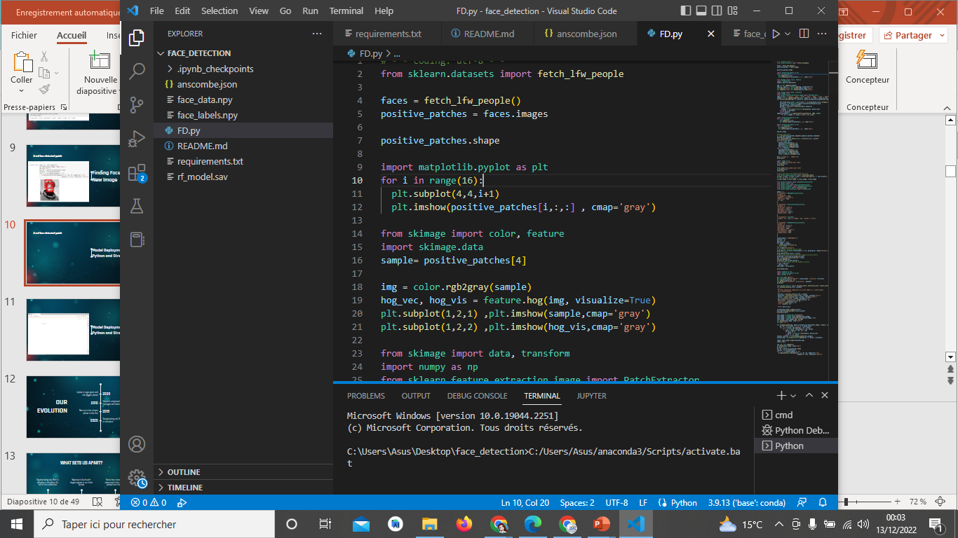
Model Deployment with Python and Streamlit

Slide 12

Model Deployment with Python and Streamlit

Slide 13

Tp3 : SKIN CANCER DETECTION WITH ANDROID APP
Réalisée par :
Yasmine BEN SAAD
Chahnez KRAIEM

Slide 14
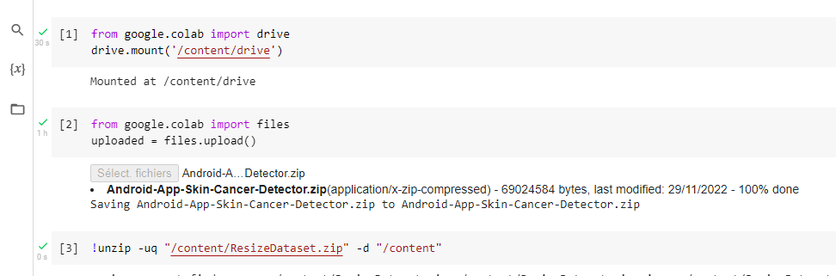
Import the project and unzip it

Slide 15
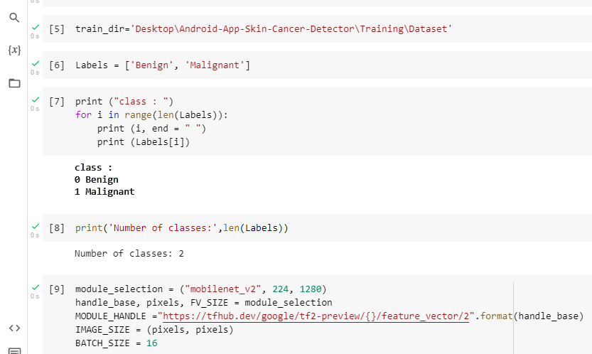
Loading the data

Slide 16
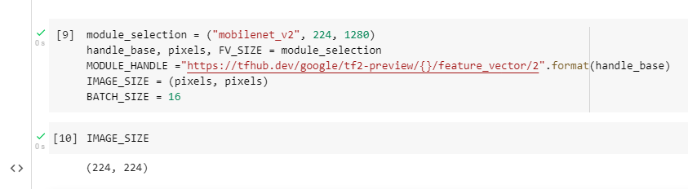
Transfer Learning with TensorFlow hub

Slide 17
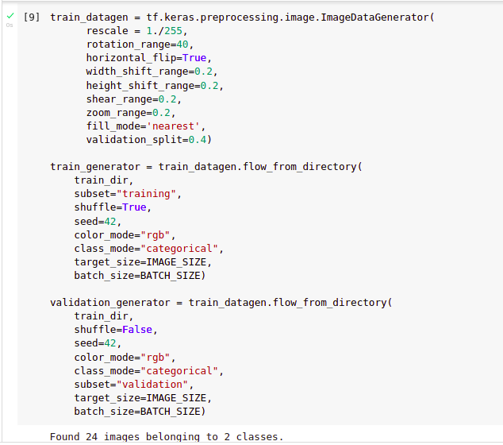
Data preprocessing

Slide 18
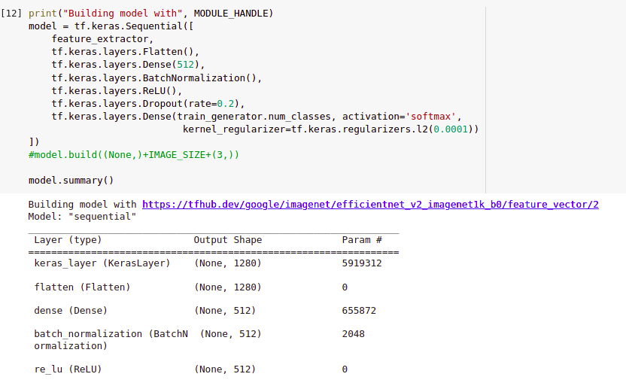
Build the model

Slide 19
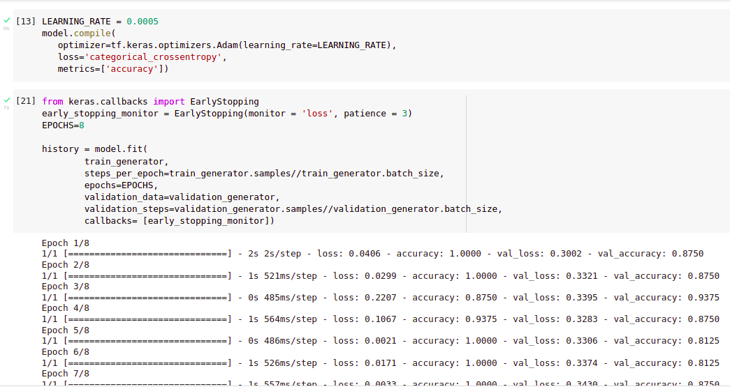
Training model

Slide 20
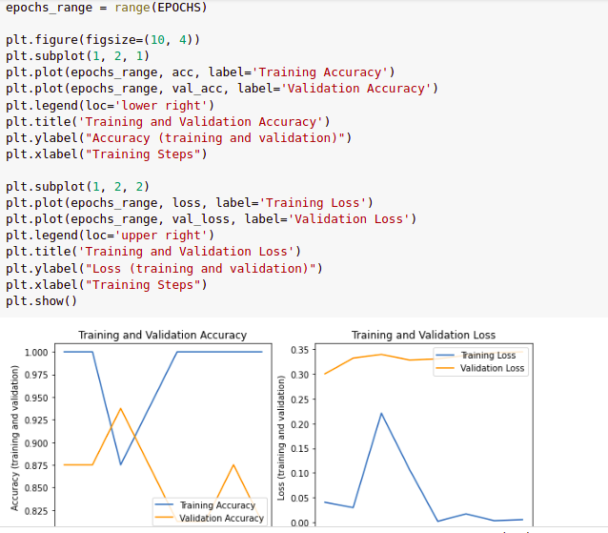
Checking performance

Slide 21
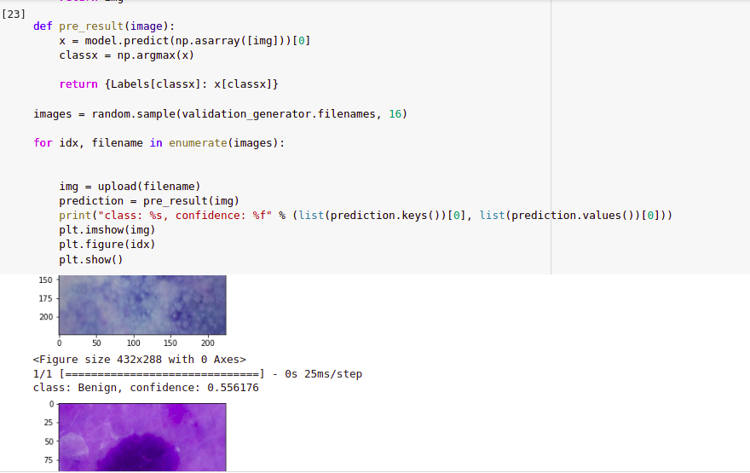
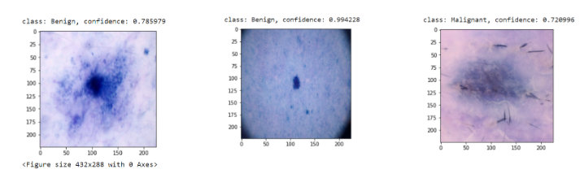
Testing at random

Slide 22
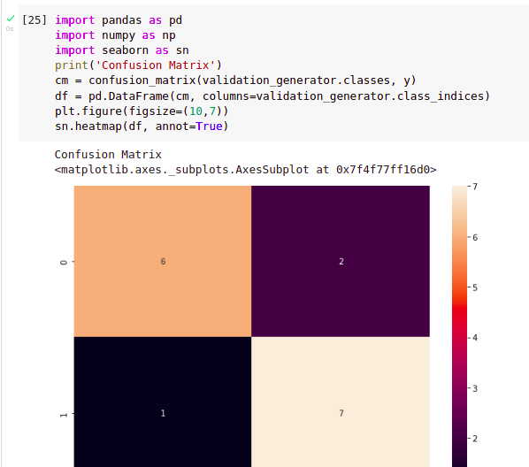
Confusion matrix

Slide 23
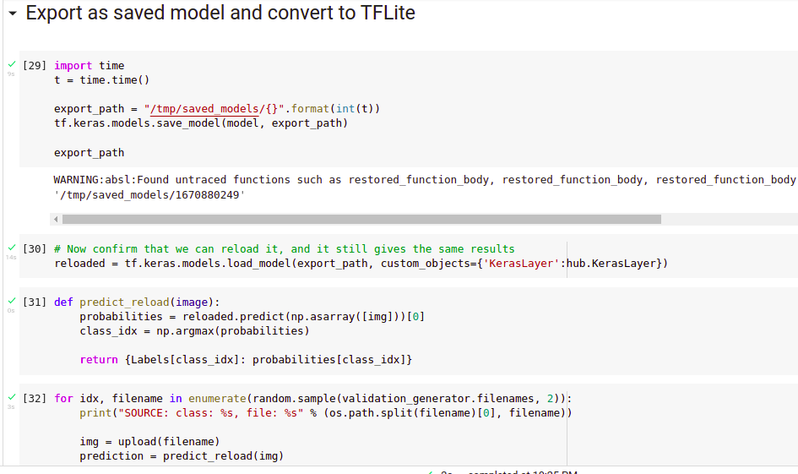
Export as saved model and convert to TFLite

Slide 24
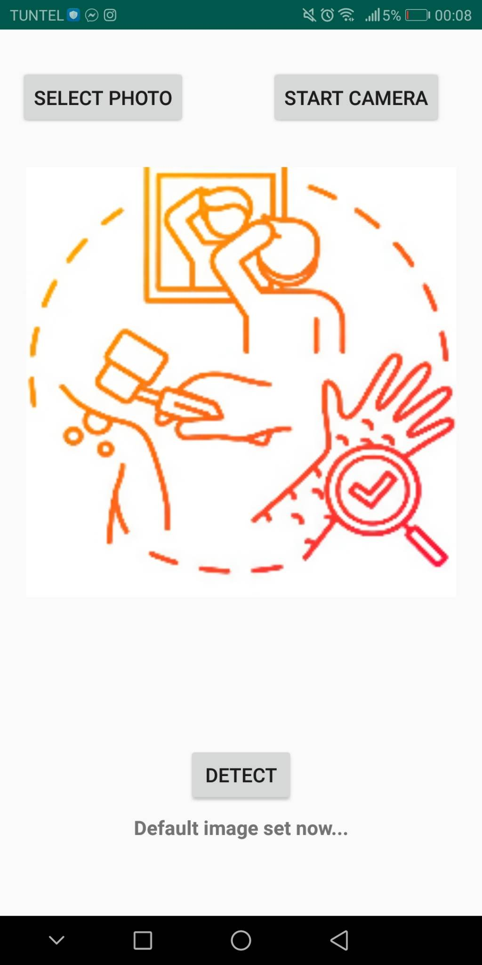
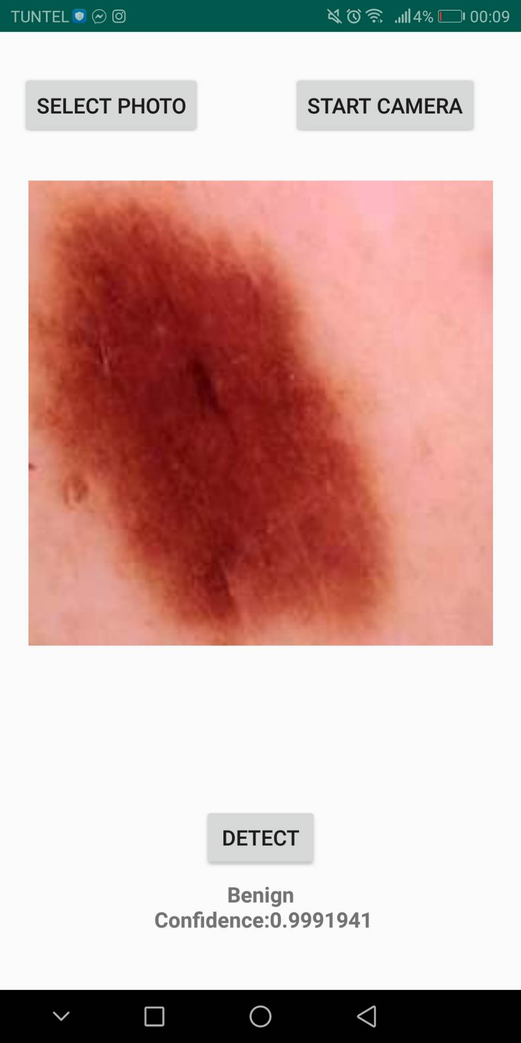

Android App

